Slide 1
Soil Conservation
6th Grade Science

Slide 2
Soil Erosion
The wearing away of soil
Loss of soil

Slide 3
Natural Causes of Soil Erosion:
Wind
Water (rain)
Gravity (hills, mountains)
Ice (glaciers, cold temperatures)

Slide 4
Other Causes of Soil Erosion:
Farming
Mining
Construction

Slide 5
Severe weather speeds up soil erosion!
Storms
Tornados
Floods

Slide 6
Soil Conservation:
Ways to preserve (or save) the soil

Slide 7
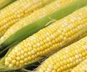
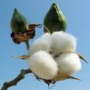
1. Crop Rotation
Planting different crops on the same field in different years

Slide 8
2. Conservation Tillage
Reducing the number of times fields are tilled, or plowed, in a year

Slide 9
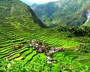
3. Terraces
Flat, step-like areas built on a hillside to prevent rainwater from running downhill

Slide 10
4. Contour Plowing
Plowing along curves or contours of a slope to prevent water from running straight downhill

Slide 11
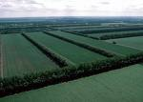
5. Wind Breaks
Rows of trees between fields to “break” or reduce the force of winds.

Slide 12
Soil Conservation Examples
Find a partner.
Read the scenario of erosion.
With your partner, decide on a solution to the problem.
Write your solution next to the scenario and then draw a picture of your solution.

